Slide 1
Discrete Mathematics
South China University of Technology

Slide 2
Chapter 9. Graphs
Graph Coloring
Section 9.8

Slide 3
Contents
1
Introduction
2
Application

Slide 4
Introduction

Slide 5
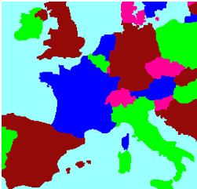
When a map is colored, two regions with a common border are customarily assigned different colors.

Slide 6
Introduction
One way to ensure that two adjacent regions never have the same color is to use a different color for each region.
However, it would be hard to distinguish similar colors.
A small number of colors should be used whenever possible.
The problem is to determine the least number of colors that can be used to color a map so that adjacent regions never have the same color.

Slide 7
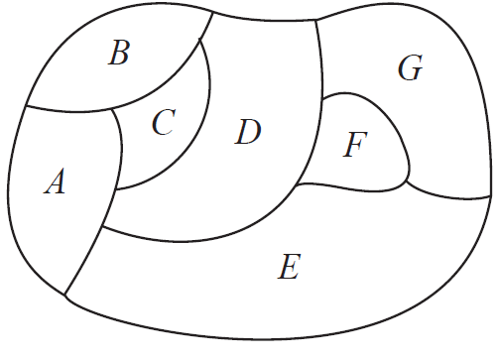
4 colors suffice, but 3 colors are not enough.

Slide 8
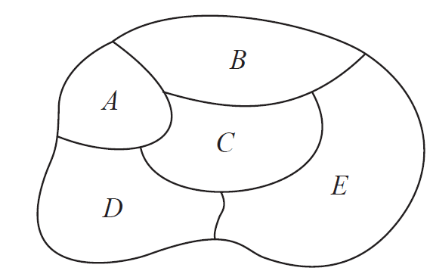
3 colors suffice, but 2 colors are not enough.

Slide 9
Dual graph 对偶图
Each map can be represented by a graph.
Each region is represented by a vertex.
Edges connect two vertices if the regions represented by these vertices have a common border.
Two regions that touch at only one point are not considered adjacent.
The resulting graph is called the dual graph对偶图 of in the plane has planar dual graph.

Slide 10
B
A
B
C
E
E
A
D
C
D

Slide 11
B
B
G
C
D
F
C
D
G
A
A
F
E
E

Slide 12
Coloring
Definition 1 A coloring of a simple graph is the assignment of a color to each vertex of the graph so that no 2 adjacent vertices are assigned the same color.
Definition 2 A chromatic number 色彩数 of a graph is the least number of colors needed for a coloring of this graph.

Slide 13
Chromatic Coloring
Two things are required to show that the chromatic number=k.
The graph can be colored with k colors.
The graph cannot be colored using fewer than k colors.

Slide 14
Chromatic Coloring
We are asking for the minimum number of colors required to color a planar map so that no two adjacent regions are assigned the same color.
This question has been studied for more than 100 year.

Slide 15
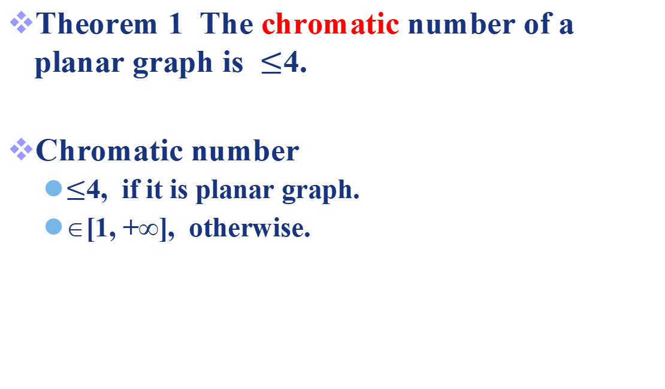
The Four Color Theorem
Theorem 1 The chromatic number of a planar graph is $≤$4.
Chromatic number
$≤$4, if it is planar graph.
∈[1, +∞], otherwise.

Slide 16
The Four Color Theorem
The Four Color Theorem was posed as a conjecture in the 1850s. It was finally proved by the American mathematics Kenneth Appel and Wolfgang Haken in 1976.
Prior to 1976, many incorrect proofs were published, often with hard-to-find errors.

Slide 17
The Four Color Theorem
The most fallacious proof in all of mathematics is the incorrect proof published by a London barrister and amateur mathematician, Alfred Kempe.
His proof is accepted as correct until 1890.
Percy Heawood found an error that made Kempe’s argument incomplete.
However, Kempe’s line of reasoning turned out to be the basis of the successful proof given by Apple and Haken.

Slide 18
The Four Color Theorem
They showed that if the Four Color Theorem were false, there would have to be a counterexample of one of approximately 2000 different types, and they then showed that none of these types exists.
They used over 1000 hours of computer time in their proof.
Their proof generated a large amount of controversy, since computers played such an important role in it.

Slide 19
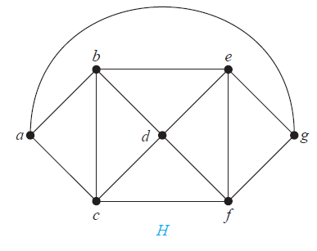
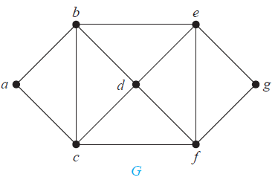
Example 1
What are the chromatic numbers of the graphs G and H ?

Slide 20
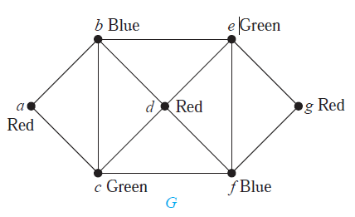
Example 1
Solution: The chromatic number of G is at least three, since a, b, and c must be assigned different colors.

Slide 21
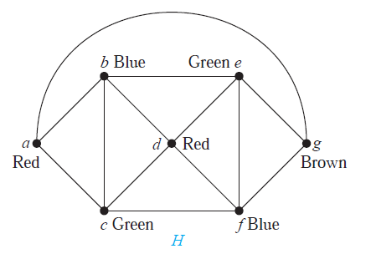
Example 1
The graph H is made up of G with {a, g}.
Hence, g is adjacent to vertices colored red, blue, and green, a fourth color, say brown, need to be used.

Slide 22
Example 2
No two vertices can be assigned the same color, since every two vertices of this graph are adjacent.
Hence, the chromatic number of Kn is n.
Four Color Theorem cannot hold for the nonplanar graph.
a
b
e
c
d
G

Slide 23
Example 3
The number of colors needed may seem to depend on m and n. Only 2 colors are needed.
Color the set of m vertices with one color and the set of n vertices with a second color.
a
b
c
d
e
f
g
G

Slide 24
Example 4
Two colors are needed to color Cn when n is even. The n-th vertex can be colored blue, since the two vertices adjacent to it, namely the (n-1)st and the first vertices, are both colored red.
a
b
f
c
e
d
C6

Slide 25
Example 4
When n is odd and n>1, the chromatic number of Cn is 3. To see this, pick an initial vertex. To use only two colors, it is necessary to alternate colors as the graph is traversed in a clockwise direction.
a
b
e
c
d
C5

Slide 26
Algorithm for coloring
The best algorithms known for finding the chromatic number of a graph have exponential worst-case time complexity.
Even the problem of finding an approximation to the chromatic number of a graph is difficult.

Slide 27
Application

Slide 28
Example 5
Scheduling Final Exam: How can the final exams at a university be scheduled so that no student has two exams at the same time?
Solution 1: G=(V, E)
a vertice= a course.
(a,b) ∈ E if there is not a common student in the courses a, b.
A Hamilton path is a schedule.
Bad ! One vertex one color.

Slide 29
Example 5
Scheduling Final Exam: How can the final exams at a university be scheduled so that no student has two exams at the same time?
Solution 2: G=(V, E)
a vertice= a course.
(a,b) ∈ E if there is a common student in the courses a, b.
A color= a time slot.
A coloring is a schedule.

Slide 30
1
7
2
1
6
3
7
2
5
4
6
3
No student has two exams at the same time.
5
4

Slide 31
Example 6
Frequency Assignments: Television channels 2 through 13 are assigned to stations in North America so that no 2 stations within 150 miles can operate on the same channel.
Solution : G=(V, E)
a vertex =a station.
(a,b) ∈ E if they are located within 150 miles of each other.
Each color represents a different channel.

Slide 32
Coloring theory can be used to allocate competitive resources among users U₁ ,··· ,U_{n} .
We model this setting by a graph G = (V,E) as follows:
a vertex= a user. V = {U₁ ,··· ,U_{n} }.
a color = a resource.
an edge= a competition/collision. {U_{i} ,U_{j} } ∈ E when U_{i} ,U_{j} compete to request a resource.

Slide 33
Example 7+历史上的考题
Index Registers 变址寄存器: For a program loop, if its frequently used variables are stored temporarily in index registers, then an efficient compilers can speede up the execution of the loops.
For a given loop, how many index registers are needed?

Slide 34
Example 7
Solution : G=(V, E)
a vertex = a variable.
(a,b) ∈ E if a,b must be stored in index registers at the same time.
A color =an index register.

Slide 35
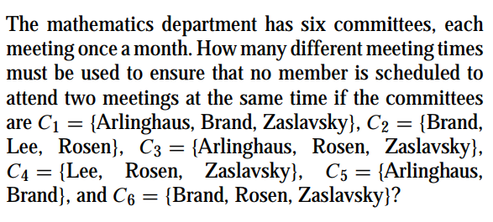
历史上的考题+作业题

Slide 36
9,10

Slide 37
End of Section 8.8
Click to edit company slogan .

